Slide 1

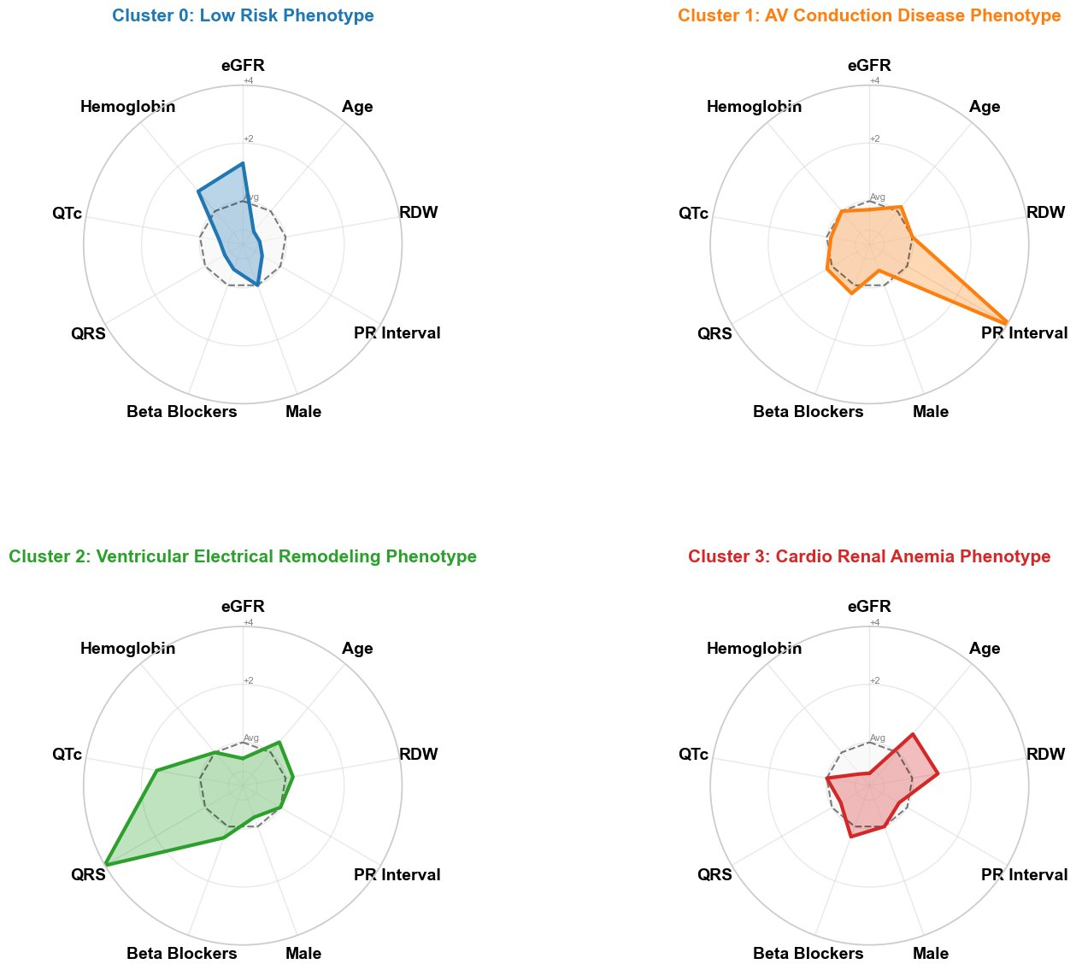
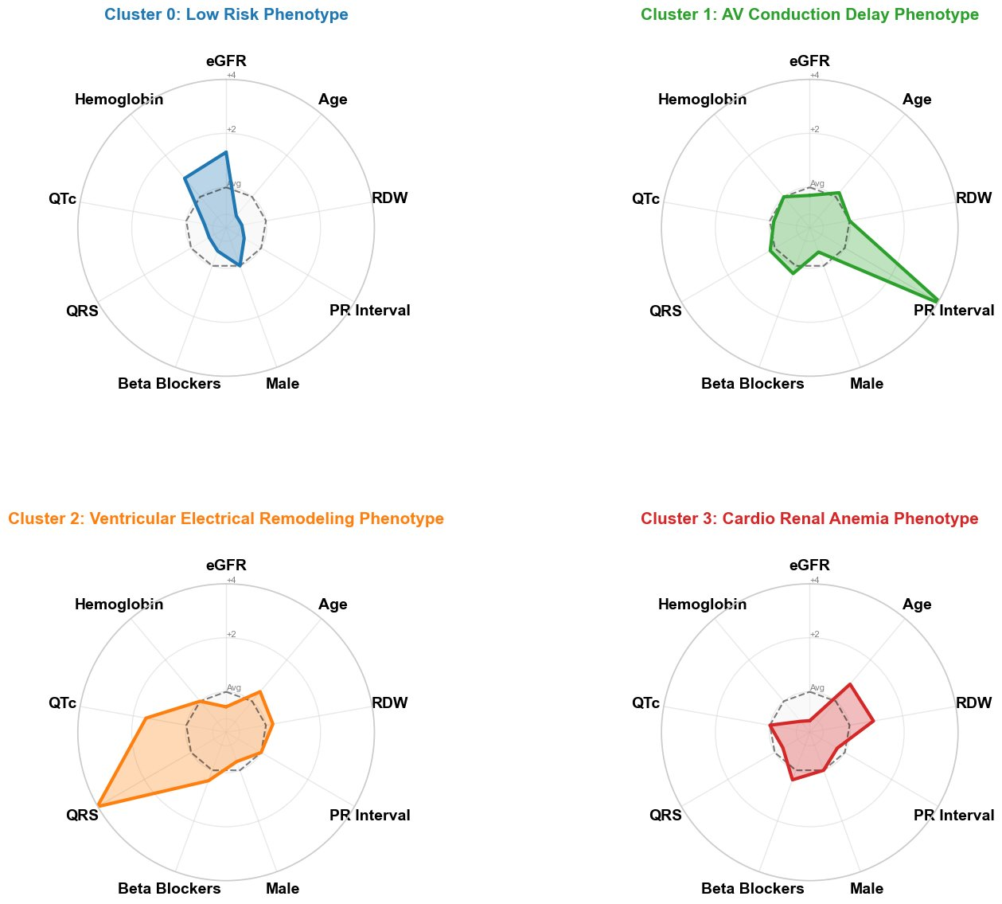
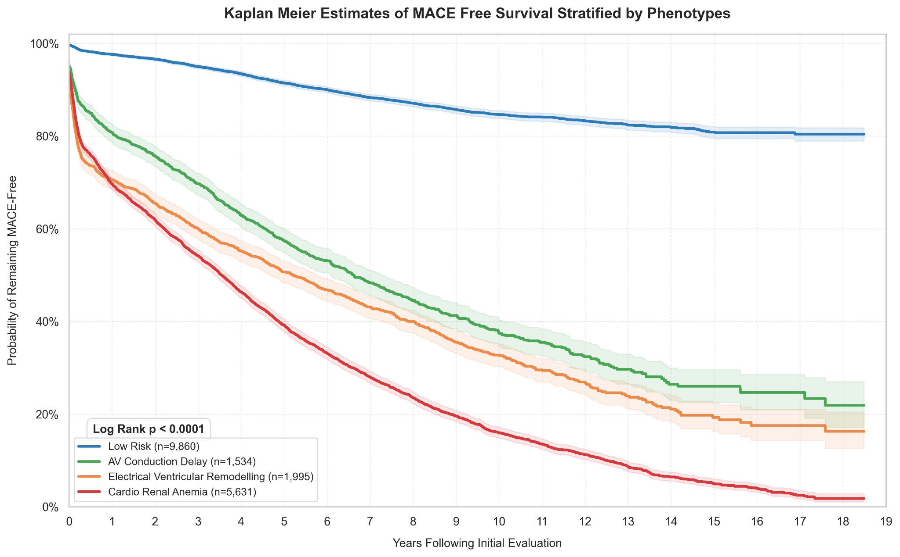
Clustering for Cardiovascular Risk Prediction in Type 2 Diabetes
Alisha Pham, Yujing Wei, Yuchen Liu
Department Advisors:: Marina Tawfik, Jennifer Campbell
Department of Computer Science, University of Toronto
Background
Methodology
Metric Results
Type 2 Diabetes (T2D) is a global epidemic affecting over 747 million people worldwide. Patients with T2D face 2-4x elevated cardiovascular risk compared to the general population.
Existing models integrating routine clinical data achieve a moderate discriminative performance (C-Index of 0.74). Critically, few study has combined both routine clinical data and unsupervised clustering to stratify cardiovascular risk.
Optimization Framework
For each hyperparameter combination:
Dimension Reduction — Fit UMAP on training, Transform validation
Clustering — K-Means on UMAP training embeddings, Assign validation patients to nearest centroid
Hyperparameter Grid
Neighbours: 30, 50, 75
Components: 5, 10, 15
Clusters: 3 – 5
Min Distance: 0.0
Risk Classification — Logistic Regression
Survival Validation — Cox Proportional Hazards Model
Final performance reported exclusively on unseen test set.
Preprocessing​
60/20/20 Split Stratified by MACE​
Resampled if missingness >5% across sets​
Features with >40% missingness excluded​
Unsupervised MICE imputation (Bayesian Ridge)​
Skewness correction (log1p/sqrt/identity)​
Z-score scaling for continuous features
Dual Gate Feature Selection​
Continuous Features​
Low variance excluded (SD < 0.01)​
Mann-Whitney U or Welch's t-test​
Binary Features​
Low prevalence excluded (<5%, >95%)​
Chi-squared test
Metric | Year 1 |  | Year 3 |  | Year 5
 | Base | Aug | Base | Aug | Base | Aug
Precision | 0.3757 | 0.3853 | 0.4939 | 0.4988 | 0.5933 | 0.6037
Recall | 0.8770 | 0.8638 | 0.9057 | 0.9047 | 0.9467 | 0.9391
Specificity | 0.7463 | 0.7601 | 0.7026 | 0.7086 | 0.6333 | 0.6516
Accuracy | 0.7657 | 0.7754 | 0.7518 | 0.7562 | 0.7464 | 0.7554
F2 Score | 0.6922 | 0.6918 | 0.7762 | 0.7781 | 0.8459 | 0.8452
Prognostic Modelling — 3 Logistic Regression models (1,3,5 Years) with features and cluster membership, 0.05 threshold sweep​
Selection — Optimal configuration maximizes average F2 Score
Research Questions
3.
4.
Metric | Base | Augmented
C-Index | 0.8429 | 0.8443
Can unsupervised clustering of EHR and ECG data identify clinically meaningful phenotypes in Type 2 Diabetes?
Do these subgroups improve Major Adverse Cardiovascular Events predictions at 1, 3 and 5 years?
Identified Phenotypes
Conclusions
Low Risk
AV Conduction Delay
Ventricular Remodelling
Cardio Renal Anemia
Clinically Distinct Phenotypes Identified
Unsupervised clustering of EHR and ECG data revealed four phenotypes with significantly different MACE risk profiles (Log rank p < 0.0001)
Strong Discriminative Performance
Both baseline and augmented model achieves a C-Index of 0.84, substantially outperforming the 0.74 benchmark reported in prior literature
Cluster Membership Did Not Improve MACE Prediction
Base and augmented models demonstrated comparable performance across all time horizons, suggesting phenotype information is already captured in the selected features
High Recall Maintained
Both models flag >86% of true high-risk patients across all time horizons
Evaluation Metrics
F2 Score
Weighs Recall twice as heavily as Precision to reflect clinical priority that missing a high risk patient carries greater cost than a false alarm
F2 = (5 · Precision · Recall) / (4 · Precision + Recall)
Recall: The proportion of truly high-risk patients correctly identified by the model out of all actual high-risk cases
Precision: The probability that a patient flagged as high-risk by the model is truly high-risk
Specificity: The proportion of truly low-risk patients correctly identified out of all actual low-risk cases
C-Index: Discriminative ranking of high and low risk patients
Figure. Radar plots of phenotypic subgroups across standardized mean values of key clinical and ECG features.. Silhouette Score = 0.5
Kaplan-Meier MACE-Free Survival by Phenotype
Limitations
References
Limited Regularization Tuning — May affect generalization
Missingness Bias — Features with high predictive ability may have been excluded
Suboptimal Metric Embedding — Shared absences are treated the same as shared presence
Spherical Clustering Bias — KMeans fails to capture non-spherical clusters
Linearity Risk Assumption — Logistic and Cox assumes linear relationships
McCoy, R. G., Swarna, K. S., Deng, Y., Herrin, J. S., Ross, J. S., Kent, D. M., ... & others. (2024). Derivation of an annualized claims-based major adverse cardiovascular event estimator in type 2 diabetes. JACC: Advances, 3(4), Article 100852.
Hand, D. J. (2009). Measuring classifier performance: A coherent alternative to the area under the ROC curve. Machine Learning, 77(1), 103–123.
Future Work
Non-Linear Risk Prediction: Neural networks to capture complex feature interactions for more accurate risk stratification
Time Dependent Modelling: Large language models to incorporate longitudinal patient data and model phenotype switching
Figure. Kaplan-Meier estimates of MACE-free survival stratified by phenotypes. Shaded bands represent 95% confidence intervals. Curves are highly stratified (p < 0.0001), confirming distinct risk profiles across the four phenotypes.

